Slide 1
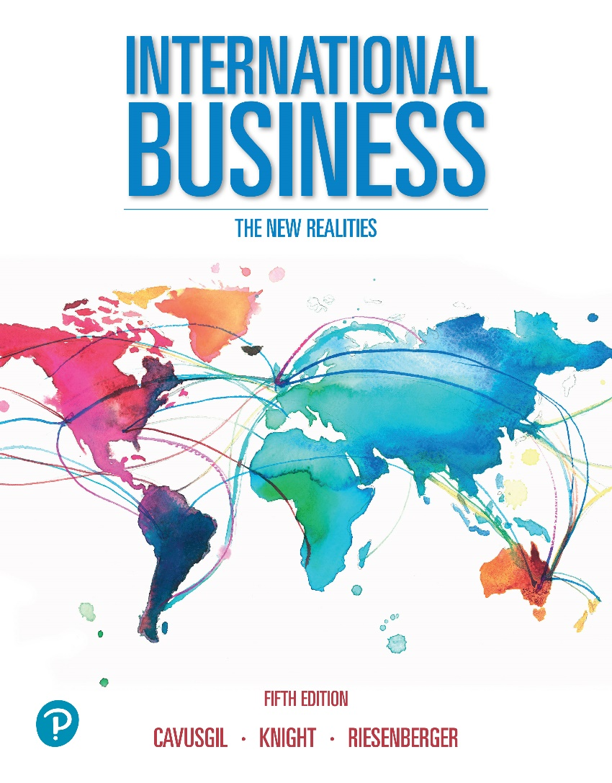

International Business: The New Realities
Fifth Edition
Chapter 7
Government Intervention and Regional Economic Integration
Slides in this presentation contain hyperlinks. JAWS users should be able to get a list of links by using INSERT+F7

Slide 2
Learning Objectives
7.1 Understand the nature of government intervention.
7.2 Know the instruments of government intervention.
7.3 Explain the evolution and consequences of government trade
intervention.
7.4 Describe how firms can respond to government trade
intervention.
7.5 Understand regional integration and economic blocs.
7.6 Identify the leading economic blocs.
7.7 Understand and explain the advantages and implications of
regional integration.

Slide 3

Government Intervention (1 of 2)
Governments intervene in trade and investment to achieve political, social, or economic objectives.
Governments impose trade and investment barriers that benefit interest groups, such as domestic firms, industries, and labor unions.
Government intervention alters the competitive landscape, by hindering or helping the ability of firms to compete internationally.
Government intervention is an important dimension of country risk.
Notes:
Economists have long used trade theories to make the case for free trade, the unrestricted flow of products, services, and physical and intellectual capital across national borders. Trade theorists argue that countries should trade with each other to make optimal use of national resources and to increase living standards. FDI-based explanations reveal how firms obtain advantages by locating factories and subsidiaries in attractive locations abroad. In short, contemporary economic theory argues that international trade and investment are good for the world. There is much empirical evidence to support free trade. One study that examined more than one hundred countries in the 50 years after 1945 found a strong association between market openness—that is, unimpeded free trade—and economic growth. Countries with an open economy enjoyed average annual per-capita GDP growth of 4.49 percent, while relatively closed countries—those with less-free trade—grew at only 0.69 percent per year. Other studies confirm that market liberalization and free trade are best for supporting economic growth and national living standards.2 In reality, however, there is no such thing as unimpeded free trade. Well before economists recognized the value of free trade, governments began intervening in business and the international marketplace in ways that obstruct the free flow of trade and investment. Intervention can take many forms. The government may impose tariffs and quotas, restrictions on international investment, bureaucratic procedures and red tape, and regulations that restrict types of business and value-chain activities. In addition, the government may provide subsidies and financial incentives intended to sustain domestic firms and industries in ways that hamper the internationalization efforts of foreign firms.

Slide 4
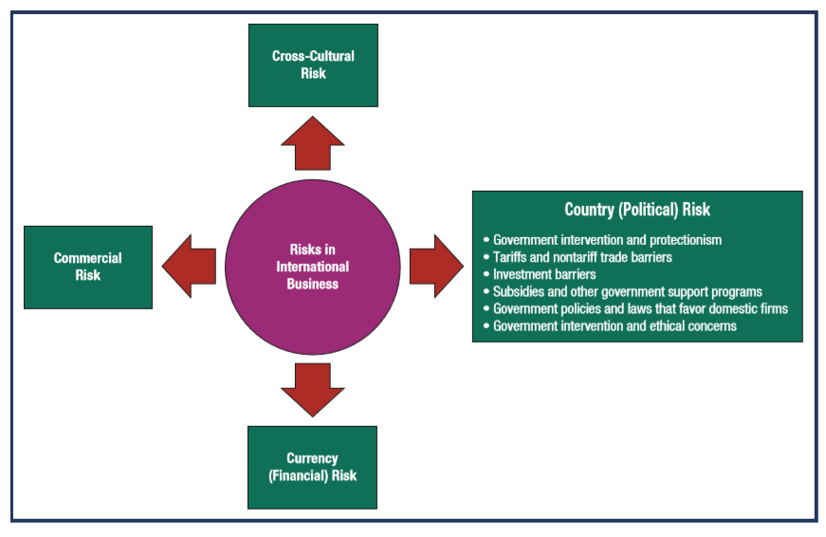
Government Intervention is a Component of Country Risk

Slide 5
Government Intervention
Think about government intervention - what are the pros and cons?
Governments impose trade and investment barriers to achieve political, social, or economic objectives.
Pros:
  Firms in advanced economies cannot compete with those in developing countries that employ low-cost labor, thus governments should impose trade barriers to block low-priced imports.
  Fear is that advanced-economy manufacturers will be undersold, wages will fall, and home country jobs will be lost.
Cons:
Blocking imports reduces the availability and increases the cost of products sold in the home market.
Protectionism may trigger retaliation, where foreign governments impose their own trade barriers, reducing sales prospects for exporters

Slide 6
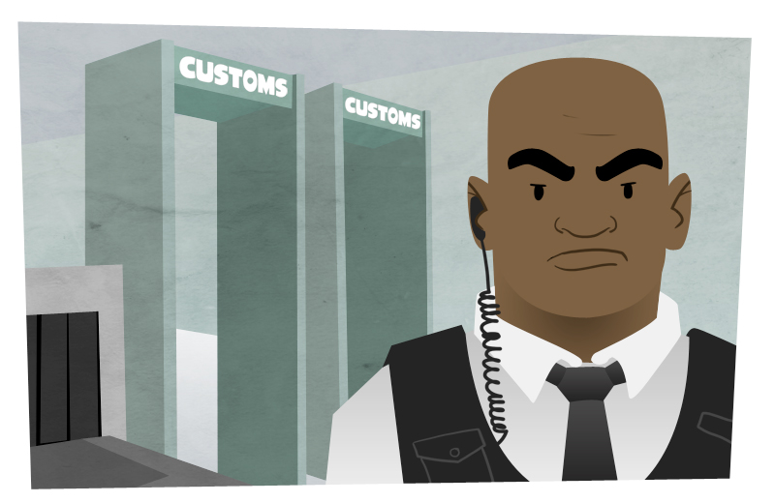
Government Intervention (2 of 2)
Protectionism – National economic policies that restrict free trade. Usually intended to raise revenue or protect domestic industries from foreign competition.
Customs – The checkpoint at national ports of entry where officials inspect imported goods and levy tariffs.
Notes:
Protectionism is typically manifested by tariffs, nontariff barriers such as quotas, and arbitrary administrative rules designed to discourage imports. A tariff (also known as a duty) is a tax imposed by a government on imported products, effectively increasing the cost of acquisition for the customer. A nontariff trade barrier is a government policy, regulation, or procedure that impedes trade through means other than explicit tariffs. Trade barriers are enforced as products pass through customs, the checkpoints at the ports of entry in each country where government officials inspect imported products and levy tariffs. An often-used form of nontariff trade barrier is a quota, a quantitative restriction placed on imports of a specific product over a specified period of time. Government intervention may also target FDI flows through investment barriers that restrict the operations of foreign firms.

Slide 7
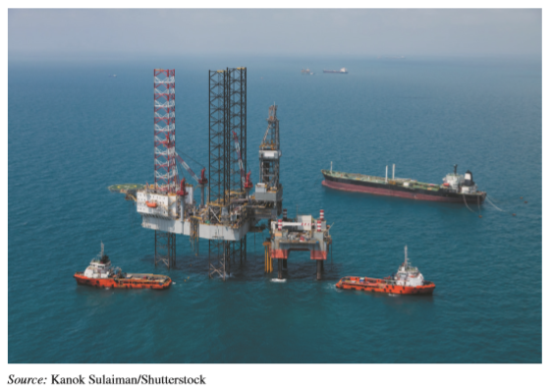
Government Intervention: Key Instruments
Tariff -A tax on imports (e.g., Citrus, textiles).
Nontariff trade barrier - Government policy, regulation, or procedure that impedes trade.
Quota - Quantitative restriction on imports of a specific product (e.g., Imports of Japanese cars).
Investment barriers - Rules or laws that hinder foreign direct investment (e.g., Mexico’s restrictions in its oil industry).
Notes:
The Mexican government restricts foreign investment in the petroleum industry in Mexico because of the industry’s strategic importance in Mexico’s economic and national security. State-owned oil company PEMEX (Petroleos de Mexico) benefits from investment barriers in Mexico that prevent foreign firms from gaining control of Mexican oil companies.

Slide 8
Example of Protectionism: U.S. Steel Industry
In the early 2000s, the U.S. government imposed tariffs on imports of foreign steel to protect U.S. steel manufacturers from foreign competition, aiming to give the U.S. steel industry time to restructure and revive itself.
However it resulted in:
  Higher steel costs.
  Increased production costs for firms that use steel, such as Ford, Whirlpool, and General Electric.
  Reduced prospects for selling products in world markets, making U.S. steel firms less competitive.
The steel tariffs were removed within two years.
Notes:
Government intervention affects the normal operation of economic activity in a nation by hindering or helping the ability of its indigenous firms to compete internationally. Often companies, labor unions, and other special interest groups convince governments to adopt policies that benefit them. For example, in the 2000s, the Bush administration imposed tariffs on the import of foreign steel into the United States. The rationale was to give the U.S. steel industry time to restructure and revive itself following years of decline due to tough competition from foreign steel manufacturers. The action may have saved hundreds of U.S. jobs. On the downside, however, the tariffs also increased production costs for firms that use steel, such as Ford, Whirlpool,
and General Electric. Higher material costs made these firms less competitive and reduced prospects for selling their products in world markets. The steel tariffs were removed within two years, but in the process of attempting to do good, the government also did some harm.

Slide 9
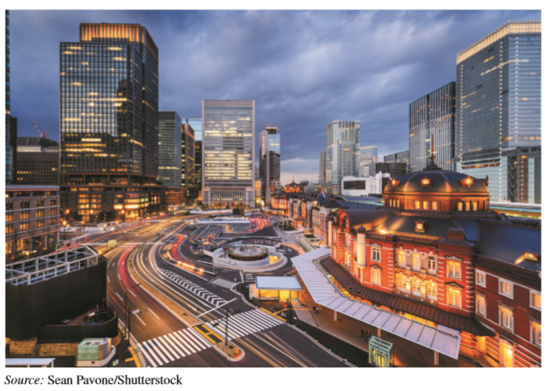
Government Intervention
Governments impose both defensive and offensive barriers to trade and investment. Pictured is the Ministry of Economy, Trade, and Industry in Japan, a typical federal agency that regulates international trade and investment.

Slide 10
Consequences of Protectionism
Reduced supply of goods to buyers.
Price inflation.
Reduced variety, fewer choices available to buyers.
Reduced industrial competitiveness.
Various adverse unintended consequences (e.g., while the home country dithers, other countries can race ahead).

Slide 11
General Rationale for Government Intervention
Governments impose tariffs and other trade barriers to achieve various goals:
To generate revenue. Tariffs are an important source of government revenue in many developing economies.
To ensure citizen safety, security, and welfare. For example, governments pass laws to prevent importation of harmful products such as contaminated food.
To pursue economic, political, or social objectives. E.g., intervention can promote domestic job growth.
To serve company and industrial interests. Government intervention can help stimulate development of domestic industries.
Notes:
Why does a government intervene in trade and investment activities? There are four main motives. First, tariffs and other forms of intervention can generate substantial revenue. For example, the “Hamilton Tariff,” enacted July 4, 1779, was the second statute passed by the newly founded United States, in order to provide revenue for the federal government. Today, Ghana and Sierra Leone generate more than 25 percent of their total government revenue from tariffs. Second, intervention can ensure the safety, security, and welfare of citizens. For example, governments pass laws to prevent the import of harmful products such as contaminated food. Third, intervention is a means for governments to pursue economic, political, or social objectives through policies that promote job growth and economic development. Fourth, intervention can help better serve the interests of the nation’s firms and industries. Governments may devise regulations to stimulate development of home-grown industries. Special interest groups often advocate trade and investment barriers that protect their interests. Consider the recent trade dispute between Mexico and the United States over Mexican cement. The U.S. government imposed duties of about $50 per ton on the import of Mexican cement after U.S. cement makers lobbied Congress. The stakes were huge, as Mexican imports can reach 10 percent of U.S. domestic cement consumption. Mexico proposed substituting import quotas in place of the tariffs. The two governments have negotiated for years to resolve the dispute.

Slide 12
Defensive Rationale for Government Intervention
Protection of the national economy - Weak or young economies sometimes need protection from foreign competitors. e.g., India imposed barriers to shield its huge agricultural sector, which employs millions.
Protection of an infant industry - A young industry may need protection, to give it a chance to grow and succeed. e.g., Japan long protected its car industry.
National security - The United States prohibits exports of plutonium and similar products to North Korea.
National culture and identity - Canada restricts foreign investment in its movie and TV industries.
Notes:
Protection of the National Economy Proponents argue that firms in advanced economies cannot compete with those in developing countries that employ low-cost labor. As labor activists called for government intervention to prevent jobs outsourcing from Europe and the United States to India, activists also seek to curtail the import of low-priced products, fearing that advanced economy manufacturers will be undersold, wages will fall, and home country jobs will be lost. Accordingly, activists urge governments to impose trade barriers that block imports. In response, critics counter that protectionism is at odds with comparative advantage; the notion that nations should engage in more international trade, not less. Trade barriers interfere with country-specific specialization of labor. When countries specialize, they perform better in the long run, delivering superior living standards to their citizens. Critics also charge that blocking imports reduces the availability and increases the cost of products sold in the home market. Industries cannot access all the input products they need. Finally, protection can trigger retaliation, resulting in foreign governments imposing their own trade barriers, which reduces sales prospects for exporters.
Protection of an Infant Industry In an emerging industry, firms are often inexperienced, lack the latest technologies and know-how. They may also lack the scale typical of larger competitors in established industries abroad. An infant industry may need temporary protection from foreign competitors. Governments can impose temporary trade barriers on foreign imports to ensure that young firms gain a large share of the domestic market. Protecting infant industries has allowed some countries to develop a modern industrial sector. For example, government intervention allowed Japan and South Korea to become dominant players in the global automobile and consumer electronics industries. Once in place, however, such protection may be hard to remove. Industry owners and workers tend to lobby to preserve government protection. Infant industries in many countries (especially in Latin America, South Asia, Eastern Europe) tend to remain dependent on government protection for many years. Industries become inefficient, causing higher taxes and higher prices for the products produced by the protected industry.
National Security Countries impose trade restrictions on products viewed as critical to national defense and security, such as military technology and computers that help maintain domestic production in security-related products. For example, Russia blocked a bid by German engineering giant Siemens to purchase the Russian turbine manufacturer OAO Power Machines, on grounds of national security. The Russian government has strict legislation that limits foreign investment in sectors considered vital to Russia’s national interests.6 Countries may also impose export controls, government measures intended to manage or prevent the export of certain products or trade with certain countries. For example, many countries prohibit exports of plutonium to North Korea because it can be used to make nuclear weapons. The United States generally blocks exports of nuclear and military technology to countries it deems state sponsors of terrorism, such as Iran, Libya, and Syria.
National Culture and Identity Should foreign entities, say the Japanese or the Saudis, be allowed to purchase national landmarks such as the Empire State Building or the Rockefeller Center in New York? In most countries, certain occupations, industries, and public assets are seen as central to national culture and identity. Governments may impose trade barriers to restrict imports of products or services seen to threaten such national assets. Switzerland has imposed trade barriers to preserve its long-established tradition in watchmaking. In the United States, authorities opposed Japanese investors’ purchase of the Pebble Beach golf course in California and the Seattle Mariners baseball team, because these assets are viewed as part of the national heritage. France does not allow significant foreign ownership of its TV stations because of concerns about foreign influence on French culture.

Slide 13
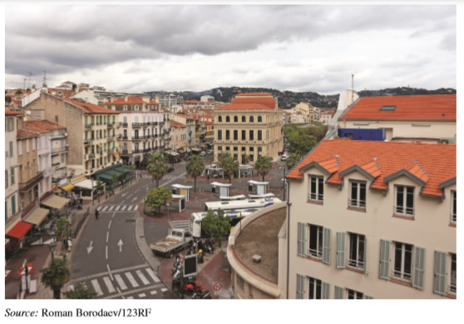
Defensive Rationale for Government Intervention
To safeguard its national culture, the French government prevents foreign companies from owning television and movie companies in France. Shown here is Cannes, the site of France’s popular film festival.

Slide 14
Offensive Rationale for Government Intervention
National strategic priorities - Protection helps ensure the development of industries that bolster the nation’s economy. Countries create better jobs and higher tax revenues when they support high value-adding industries, such as I T, automotive, pharmaceuticals, or financial services.
Increase employment - Protection helps preserve domestic jobs, at least in the short term. However, protected industries become less competitive over time, especially in global markets, leading to job loss in the long run.
Notes:
National Strategic Priorities Government intervention sometimes aims to encourage the development of industries that bolster the nation’s economy. It is a proactive variation of the infant industry rationale and related to national industrial policy. Countries with many high-tech or high-value-adding industries, such as information technology, pharmaceuticals, car manufacturing, or financial services, create better jobs and higher tax revenues than economies based on low-value-adding industries, such as agriculture, textile manufacturing, or discount retailing. Accordingly, governments in Germany, Japan, Norway, South Korea, and numerous other countries have devised policies that promote the development of relatively desirable industries. The government may provide financing for investment in high-tech or high-value-adding industries, encourage citizens to save money to ensure a steady supply of loanable funds for industrial investment, and fund public education to provide citizens the skills and flexibility they need to perform in key industries.
Increasing Employment Governments often impose import barriers to protect employment in designated industries. Insulating domestic firms from foreign competition stimulates national output, leading to more jobs in the protected industries. The effect is usually strongest in import-intensive industries that employ much labor. For example, the Chinese government has traditionally required foreign companies to enter its huge markets through joint ventures with local Chinese firms. This policy creates jobs for Chinese workers. For example, a joint venture between Shanghai Automotive Industry Corporation (SAIC) and Volkswagen created jobs in China.

Slide 15
Types and Effects of Government Intervention
Intervention Type | Definition | Practical Effect on Customers, Firms, or Government
Tariff | Tax imposed on imported products. | Increases cost to the importer, exporter, and usually the buyer of the product; discourages product imports; generates government revenue
Quota | Quantitative restriction on imports of a product during a specified period of time. | Gives early importers monopoly power and the ability to charge higher prices; harms late importers; usually results in higher prices to the buyer
Local content requirements | Requirement that firms include a minimum percent of locally sourced inputs in the production of given products or services. | Discourages imports of raw materials, parts, and supplies, which harms manufacturers' sourcing options; may result in higher costs and lower product quality for buyers
Regulations and technical standards | Safety, health, or technical regulations; labeling requirements. | May hinder the entry of imported products and reduce the quantity of available products, resulting in higher costs to importers and buyers
Notes:
Tariffs Some countries impose export tariffs, taxes on products exported by their own companies. For example, Russia charges a duty on its oil exports with the intention of generating government revenue and maintaining high oil stocks within Russia. The most common type of tariff, however, is the import tariff, a tax levied on imported products. Import tariffs are usually ad valorem—that is, they are assessed as a percentage of the value of the imported product. Or a government may impose a specific tariff—a flat fee or fixed amount per unit of the imported product—based on weight, volume, or surface area, such as barrels of oil or square meters of fabric. A revenue tariff is intended to raise money for the government. A tariff on cigarette imports, for example, produces a steady flow of revenue. A protective tariff aims to protect domestic industries from foreign competition. A prohibitive tariff is one so high that no one can import any of the items.
Quotas restrict the physical volume or value of products that firms can import into a country. In a classic type of quota, the U.S. government imposed an upper limit of roughly two million pounds on the total amount of sugar that can be imported into the United States each year. Sugar imports that exceed this level face a tariff of several cents per pound. The upside is that U.S. sugar producers are protected from cheaper imports, giving them a competitive edge over foreign sugar producers. The downside is that U.S. consumers and producers of certain types of products, such as Hershey’s and Coca-Cola, pay more for sugar. It also means companies that manufacture products containing sugar may save money by moving production to countries that do not impose quotas or tariffs on sugar.
Governments can impose voluntary quotas, under which firms agree to limit exports of certain products. These are also known as voluntary export restraints, or VERs. For example, in 2005, import quotas in the European Union led to an impasse in which millions of Chinese-made garments piled up at ports and borders in Europe. The EU impounded the clothing because China had exceeded the voluntary import quotas it had negotiated with the EU. The action created hardship for European retailers.
Local content requirements require manufacturers to include a minimum of local value added—that is, production that takes place locally. Local content requirements are usually imposed in countries that are members of an economic bloc, such as the EU and NAFTA. The so-called rules of origin requirement specifies that a certain proportion of products and supplies, or of intermediate goods used in local manufacturing, must be produced within the bloc. For a car manufacturer, the tires or windshields it purchases from another firm are intermediate goods. When the firm does not meet this requirement, the products become subject to trade barriers that member governments normally impose on nonmember countries. Thus, producers within the NAFTA zone of Canada, Mexico, and the United States pay no tariffs on the products and supplies they obtain from each other, unlike countries such as China or the United Kingdom that are not part of NAFTA. Roughly 60 percent of the value of a car manufactured within NAFTA must originate within the NAFTA member countries. If this condition is not met, the product becomes subject to the tariffs charged to non-NAFTA countries.

Slide 16
Government Intervention Types and Effects
Intervention Type | Definition | Practical Effects on customers, Firms, or Government
Administrative and bureaucratic procedures | Complex procedures or requirements imposed on importers or f01eign investors that hinder trade and investment. | Slows the import of products or services; hinders or delays firms' investment activities
FDI and ownership restrictions | Rules that limit the ability of foreign firms to invest in certain industries or acquire local firms. | Limits how much foreigners can invest in a country, and/or the proportion of ownership that foreigners can hold in firms in the country
Subsidy | Financing or other resources that a government grants to a firm or group of firms, to ensure their survival or success. | Increases the competitive advantage of the grantee while diminishing the competitive advantages of those that do not receive the subsidy
Notes:
Government regulations and technical standards are another type of nontariff trade barrier. Examples include safety regulations for motor vehicles and electrical equipment, health regulations for hygienic food preparation, labeling requirements that indicate a product’s country of origin, technical standards for computers, and bureaucratic procedures for customs clearance, including excessive red tape and slow approval processes. The European Union strictly regulates food that has been genetically modified (GM), a policy that blocks some food imports into Europe from the United States. In China, the government requires foreign firms to obtain special permits to import GM foods. In 2010, the Chinese government clashed with Google over the latter’s refusal to censor its Web search and news services in mainland China. The Chinese government has a history of regulating online news and other content that it considers illegal.
Governments may impose administrative or bureaucratic procedures that hinder the activities of importers or foreign firms. For example, the opening vignette revealed how India’s business sector is burdened by countless regulations, standards, and administrative hurdles at the state and federal levels. In Mexico, government-imposed bureaucratic procedures led United Parcel Service to temporarily suspend its ground delivery service across the U.S.-Mexican border. Similarly, the United States barred Mexican trucks from entering the United States on the grounds that they were unsafe. Business regulations vary worldwide. Many countries in Africa and Latin America impose countless bureaucratic procedures that hinder commercial activities and business start-ups. By contrast, Australia, Britain, Canada, Ireland, New Zealand, and Singapore impose relatively few such procedures. Saudi Arabia is home to various restrictive practices that hinder international trade. Every foreign business traveler to the Arab kingdom must hold an entry visa that can be obtained only by securing the support of a sponsor—a Saudi citizen or organization who vouches for the visitor’s actions. Because few Saudis are willing to assume such responsibility, foreigners who want to do business in Saudi Arabia face great difficulty.
Convoluted administrative procedures are widespread in national customs agencies. The revenue generated by tariffs depends on how customs authorities classify imported products. Products often appear to fit two or more tariff categories. For example, a sport utility vehicle could be classified as a truck, a car, or a van. Each of these categories can entail a different tariff. Depending on the judgment of the customs agent, the applicable tariff might end up being high or low. Because thousands of categories exist for customs classification, a product and its corresponding tariff can be easily misclassified, by accident or intent.

Slide 17
Sampling of Import Tariffs
Country | Average Import Tariffs Average Import Tariff
Country | Agricultural Products | Nonagricultural Products
Australia | 1.2% | 3.0%
Brazil | 10.0 | 14.1
Canada | 15.6 | 2.3
China | 15.5 | 9.0
European Union | 11.1 | 4.2
India | 32.7 | 10.2
Japan | `13.1 | 2.5
Mexico | 14.6 | 5.7
United States | 5.2 | 3.2
Note: Exhibit shows the average, most favored nation-applied tariff. Source: Based on World Tariff Profiles 2017, World Trade Organization, www.wto.org.
Notes:
Import tariffs can generate substantial revenue for national governments. This helps explain why they are common in developing economies. Even in advanced economies, tariffs provide a significant source of revenue for the government. The United States charges tariffs on many consumer, agricultural, and labor-intensive products. Interestingly, the United States typically collects as much tariff revenue on shoes as on cars— about $1.9 billion in 2007. The European Union applies tariffs of up to 215 percent on meat, 116 percent on cereals, and 133 percent on sugar and confectionary products. Exhibit provides a sample of import tariffs in selected countries. Despite its reputation as a challenging market to enter, Japan maintains average tariffs for nonagricultural products at low levels. Under the North American Free Trade Agreement (NAFTA), Canada, Mexico, and the United States have eliminated nearly all tariffs on product imports from each other. However, Mexico maintains significant tariffs with the rest of the world—21.5 percent for agricultural products and 7.1 percent for nonagricultural goods. India’s tariffs are relatively high, especially in agriculture, where the rate is 31.7 percent. India’s tariff system lacks transparency, and officially published tariff information is sometimes hard to find. China has reduced its tariffs since joining the World Trade Organization (WTO, www.wto.org) in 2001, but trade barriers remain high in some areas.

Slide 18
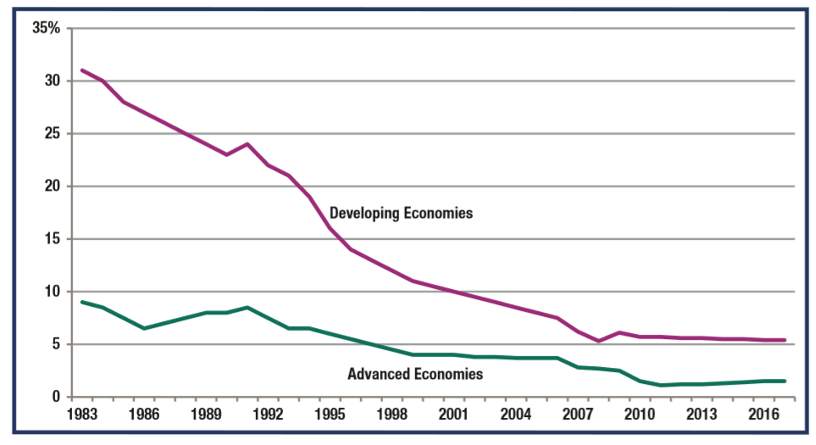
Decline in Average Tariff Rates
Source: Based on the World Bank, http://data.worldbank.org

Slide 19
Number of State-Owned Multinational Enterprises, by Country
Source: UNCTAD, World Investment Report (New York: United Nations, 2017), www.unctad.org.
Notes:
State-owned multinational enterprises (SOMNEs) receive generous subsidies and other resources from their home-country. China has the most SOMNEs, approximately 257. China Minmetals, Shanghai Automotive, and other Chinese SOMNEs account for as much as 40 percent of China’s economic output. In total, China is home to some 150,000 state-owned enterprises, of which about 50,000 (33 percent) are owned by the central government and the remainder by local governments.

Slide 20
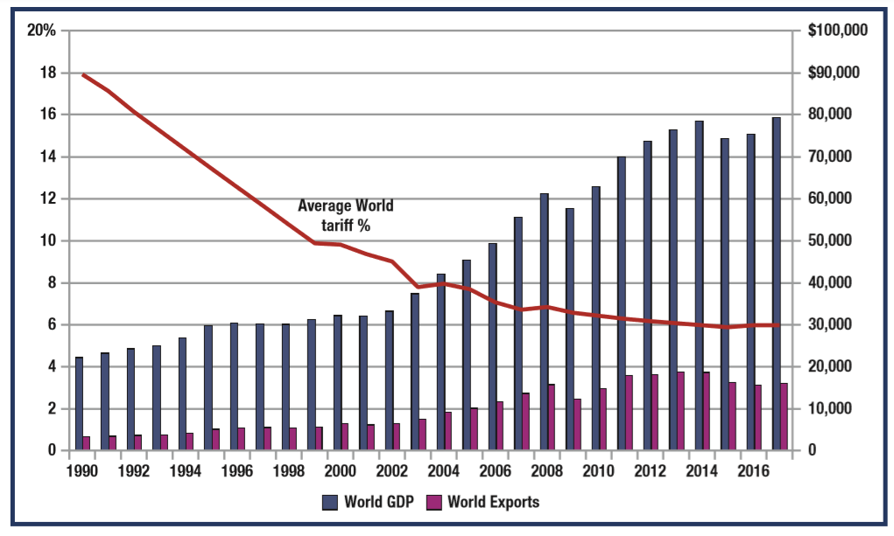
Relationship between Tariffs, World GDP, and the Volume of World Trade
Note: Tariffs given as average percent (red line), World G D P given in billions of U.S. dollars (blue column), and Volume of World Exports given in billions of U.S. dollars (purple column). Left axis measures tariffs. Right axis measures world G D P and volume of world exports. Sources: Based on International Monetary Fund World Economic Outlook Database, at www.imf.org; UNCTAD, http://unctadstat .unctad.org; World Bank, http://data.worldbank.org.
Notes:
Average tariffs have declined over time. Simultaneously, as shown in the Exhibit, world GDP and especially world trade have flourished. Decreasing trade barriers are a major factor in the growth of global commerce and consequently in rising incomes around the world. Firms that participate actively in international trade and investment not only improve their performance but also contribute to reducing global poverty.

Slide 21
Tariffs are Widespread
Harmonized code - Standardized worldwide system that determines tariff amount.
In developing economies, tariffs are common.
In advanced economies, tariffs provide significant revenue.
For example, the U.S. typically collects high tariffs (often 48 percent) on imports of basic, low-quality shoes, and low tariffs (just 9 percent) on luxury shoes. Low-income shoe buyers end up paying the highest tariffs.
The European Union applies tariffs up to 191%
on meat, 118% on cereals, and 106% on sugar.
Notes:
The amount of a tariff is determined by examining a product’s harmonized code. Products are classified under about 7,000 different unique codes in the harmonized tariff or harmonized code schedule, a standardized system used worldwide. Without this system, firms and governments might have differing opinions on product definitions and the tariffs charged.
Import tariffs can generate substantial revenue for national governments. This helps explain why they are common in developing economies. Even in advanced economies, tariffs provide a significant source of revenue for the government. The United States charges tariffs on many consumer, agricultural, and labor-intensive products. Interestingly, the United States typically collects as much tariff revenue on shoes as on cars— about $1.9 billion in 2007. The European Union applies tariffs of up to 215 percent on meat, 116 percent on cereals, and 133 percent on sugar and confectionary products.

Slide 22
Import Tariffs Have Been Declining
Governments have reduced tariffs over time, mainly via the General Agreement on Tariffs and Trade (G A T T), which became the World Trade Organization (W T O).
Economic integration also leads to lower tariffs, but only within economic blocs. e.g., Under N A F T A, Mexico eliminated nearly all tariffs on imports from the U.S., but maintains tariffs with the rest of the world.
China reduced its tariffs since joining the W T O in 2001.
Firms bypass tariffs by entering countries via F D I. E.g., Toyota built factories in the U.S. partly to avoid tariffs.
Notes:
China has reduced its tariffs since joining the World Trade Organization (WTO, www.wto.org) in 2001, but trade barriers remain high in some areas. In Africa, over half of all workers are employed in agriculture. Significant tariffs and other trade barriers in the advanced economies hinder imports of agricultural goods from Africa, which worsens already-severe poverty in many African countries. Because high tariffs inhibit free trade and economic growth, governments have tended to reduce them over time. This was the primary goal of the General Agreement on Tariffs and Trade (GATT; now the WTO). Countries as diverse as Chile, Hungary, Turkey, and South Korea have liberalized their previously protected markets, lowering trade barriers and subjecting themselves to greater competition from abroad. Developing economies have been lowering their tariff rates since the early 1970s. Continued reductions represent a major driver of market globalization

Slide 23
Subsidies
Subsidies are government grants (monetary or other resources) to firm(s), intended to ensure their survival or success by facilitating production at reduced prices, or encouraging exports.
Grants include cash, tax breaks, infrastructure construction, or government contracts at inflated prices.
Examples:
In China, Shanghai Automotive ($123b ann. sales) and numerous other M N Es are partly owned by the Chinese government, and receive huge financial resources.
Europe and the U.S. provide huge agricultural subsidies to farmers. E U subsidies represent 40% of the E U budget.
Notes:
A large MNE that charges very low prices could conceivably drive competitors out of a foreign market, achieving a monopoly, with the ability to raise prices later. Governments in the importing country often respond to dumping by imposing an antidumping duty—a tax imposed on products deemed to be dumped and thereby causing injury to producers of competing products in the importing country. The WTO allows this practice.17 The duties are generally equal to the difference between the product’s export price and their normal value. Government subsidies are not always direct or overt. For example, governments may support home country businesses by funding R&D, granting tax exemptions, and offering business development services such as trade missions, and privileged access to key foreign contacts. Most countries have agencies and ministries that provide such services to facilitate the international activities of their own firms. Examples include the Department of Foreign Affairs and International Trade in Canada (www.dfait-maeci.gc.ca), U.K. Trade & Investment in Britain (www.uktradeinvest.gov.uk), and the International Trade Administration of the U.S. Department of Commerce (www.doc.gov).
Related to subsidies are governmental investment incentives, transfer payments or tax concessions made directly to individual foreign firms to entice them to invest in the country. Hong Kong’s government put up most of the cash to build the Hong Kong Disney park (park.hongkongdisneyland.com). While the park and facilities cost about $1.71 billion, the government provided Disney an investment of $1.74 billion to develop the site. Recently, Austin, Texas, and Albany, New York, competed for the chance to have the Korean manufacturer Samsung Electronics (www.samsung.com) build a semiconductor plant in their regions. Austin offered $225 million worth of tax relief and other concessions in its successful bid to attract Samsung’s $300 million plant, estimated to create nearly 1,000 new jobs locally. To entice MNEs to establish local production facilities, Macedonia offers incentives like low corporate taxes, immediate access to utilities, and financial support (see www.investinmacedonia.com).
Such incentives often help the economic development in a particular region or community. In the 1990s, Germany encouraged foreign companies to invest in the economically disadvantaged East German states by providing tax and investment incentives. The government of Ireland has undertaken various initiatives aimed at promoting Ireland as a place to do business. It targeted foreign companies in the high-tech sector— including medical instruments, pharmaceuticals, and computer software—and offered preferential corporate tax rates of 12 percent. These targeted efforts paid dividends by creating substantial new employment and helping diversify the Irish economy away from agricultural activities. Governments also support domestic industries by adopting procurement policies that restrict purchases to home country suppliers. Several governments require that air travel purchased with government funds be booked with home country carriers. Such policies are especially common in countries with large public sectors, such as China and Russia. In the US, government agencies favor domestic suppliers unless their prices are high compared to foreign suppliers. In Japan, government agencies may not even consider foreign bids, regardless of pricing. Public procurement agencies may impose requirements that exclude foreign suppliers.

Slide 24
Economic Freedom
Economic freedom is the absence of government coercion so that people can work, produce, consume, and invest however they want to.
The Index of Economic Freedom assesses the rule of law, trade barriers, regulations, and other criteria.
  Virtually all advanced economies are “free”.
  Emerging markets are either “free” or “mostly free”.
  Most developing economies are “mostly unfree” or “repressed”.
Economic freedom flourishes with appropriate of intervention; too much regulation harms the economy.
Notes:
One way of evaluating the effects of government intervention is to examine each nation’s level of economic freedom, defined as the “absence of government coercion or constraint on the production, distribution, or consumption of goods and services beyond the extent necessary for citizens to protect and maintain liberty itself. In other words, people are free to work, produce, consume, and invest in the ways they feel are most productive.” An Index of Economic Freedom is published annually that measures economic freedom in 161 countries.

Slide 25
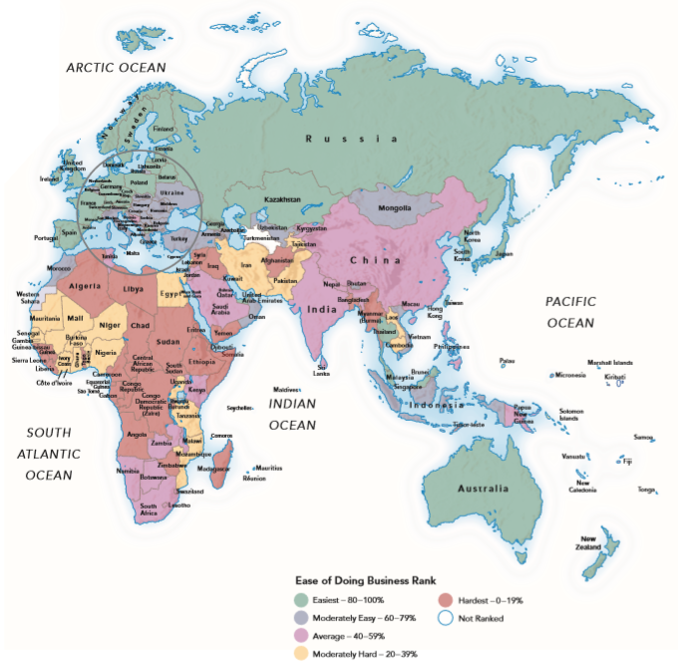
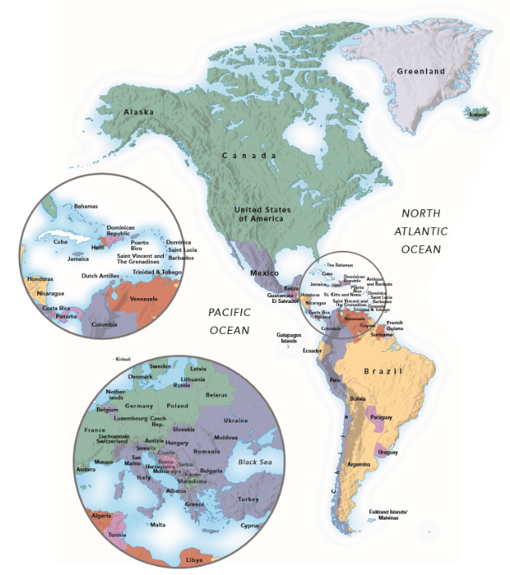
Countries Ranked by Ease of Doing Business
Sources: Based on Doing Business: Economy Rankings and Doing Business 2018, World Bank Group, Washington, D C, http://www.doingbusiness.org/rankings
Notes:
The exhibit shows the ease of doing business for each country. Most of the easiest countries are advanced economies that enjoy high living standards. The easiest group also includes numerous emerging markets that have simplified their regulatory environment in an effort to encourage entrepreneurship and investment. The exhibit’s moderately hard and hardest countries are relatively difficult places to do business and are characterized by severe poverty and other hardships.

Slide 26

Evolution of Government Intervention
Protectionist tendencies, the Great Depression, and isolationism shaped early 20th century world trade.
The Smoot-Hawley Act (1930) raised U.S. tariffs to more than 50% (compared to only 3% today).
Trade policies greatly reduced tariffs after WWII.
In 1947, 23 nations signed the General Agreement on Tariffs and Trade (G A T T). The G A T T:
  Reduced tariffs via continuous worldwide trade negotiations;
  Created an agency to supervise world trade
  Created a forum for resolving trade disputes.
Notes:
A century ago, trade barriers worldwide were relatively high. The trading environment worsened through two world wars and the Great Depression. In 1930, the United States passed the Smoot-Hawley Tariff Act, which raised U.S. tariffs to near-record highs of more than 50 percent, compared to only about 3 percent today. Tariffs that other countries imposed to retaliate against Smoot-Hawley choked off foreign markets for U.S. agricultural products, leading to plummeting farm prices and many bank failures. In an effort to revive trade, the U.S. government began to reduce restrictive tariffs. By the late 1940s, prudent policy-making had led to substantial tariff reductions worldwide.

Slide 27
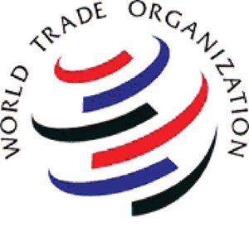
The GATT
The GATT introduced the concept of most favored nation (renamed normal trade relations), according to which each member nation agreed to extend the tariff reductions covered in a trade agreement with one country to all other countries. A concession to one became a concession to all.
In 1995 the GATT was superseded by
the World Trade Organization (W T O),
and grew to include 150 member nations.
The GATT and W T O presided over the
greatest global decline in trade barriers in history.
Notes:
In 1947, twenty-three nations signed the General Agreement on Tariffs and Trade (GATT), the first major effort to systematically reduce trade barriers worldwide. The GATT created: (1) a process to reduce tariffs through continuous negotiations among member nations, (2) an agency to serve as watchdog over world trade, and (3) a forum for resolving trade disputes. The GATT introduced the concept of most favored nation (renamed normal trade relations in 1997), according to which each signatory nation agreed to extend the tariff reductions covered in a trade agreement with a trading partner to all other countries. Thus, a concession to one country became a concession to all. Eventually, the GATT was superseded by the WTO in 1995 and grew to include about 150 member nations. The organization proved extremely effective and resulted in the greatest global decline in trade barriers in history.

Slide 28
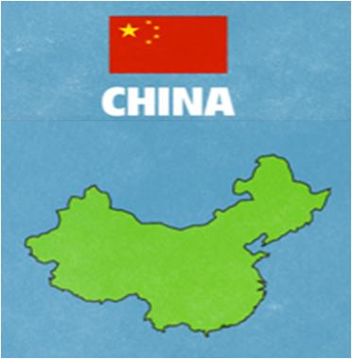
Market Liberalization in China
In 1949, China established communism and centralized economic planning.
Agriculture and manufacturing were controlled by inefficient state-run industries.
The country was long closed to international trade.
In the 1970s, China liberalized its
economy.
In 2001, China joined the W T O.
China is now a key member of
world trading system.
Notes:
After establishing a communist government in 1949, China relied on centralized economic planning, and agriculture and manufacturing were controlled by inefficient state run industries. The country remained relatively closed to international trade until the 1970s, when it began to liberalize its economy. In 1992, China joined Asia-Pacific Economic Cooperation (APEC), a free-trade organization similar to the European Union. In 2001, it joined the WTO and committed to reducing trade barriers and increasing intellectual property protection. Trade has stimulated the Chinese economy. By 2007, its GDP was more than ten times the 1977 level, and the value of exports had reached $1.5 trillion. China has become a leading exporter of manufactured products and home to numerous large MNEs that compete with Western firms.

Slide 29
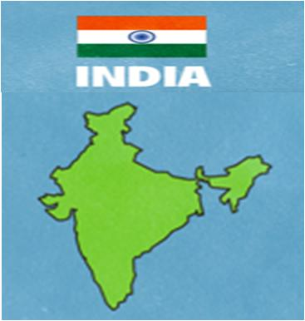
Market Liberalization in India
Following independence from Britain in 1947, adopted a quasi-socialist model of isolationism and government control.
High trade barriers, state intervention, a large public sector, and central planning resulted in poor economic performance.
In the 1990s, markets opened to foreign trade and investment; state enterprises were privatized.
Protectionism has declined, but high
tariffs (averaging 20%) and F D I
limitations remain.
Notes:
Since gaining independence from Britain in 1947, India adopted a quasi-socialist model of isolationism and strict government control. High trade and investment barriers, state intervention in labor and financial markets, a large public sector, heavy regulation of business, and central planning all contributed to the nation’s poor economic performance over several decades. Beginning in the early 1990s, India began to open its markets to foreign trade and investment. Free-trade reforms, combined with privatization of state enterprises, have progressed slowly. Protectionism has declined, but FDI limitations and high tariffs (more than 40 percent in agricultural products) are still in place.

Slide 30

How Firms Can Respond to Government Intervention
Research to gather knowledge and intelligence. Understand trade and investment barriers abroad. Scan the business environment to identify the nature of government intervention.
Choose the most appropriate
entry strategies. Most firms choose exporting as their initial trategy, but if high tariffs are present, other strategies should be considered, such as licensing, or F D I and J Vs that allow the firm to produce directly in the market.
Notes:
Research to Gather Knowledge and Intelligence Experienced managers continually scan the business environment to identify the nature of government intervention and to plan market-entry strategies and host country operations. They review their return-on-investment criteria to account for the increased cost and risk of trade and investment barriers. For example, the EU is devising new guidelines that affect company operations in areas ranging from product liability laws to standards for investment in European industries.
Choose the Most Appropriate Entry Strategies Tariffs and most nontariff trade barriers apply to exporting, whereas investment barriers apply to FDI. Most firms choose exporting as their initial entry strategy. However, if high tariffs are present, managers should consider other strategies, such as FDI, licensing, and joint ventures that allow the firm to operate directly in the target market, avoiding import barriers. For example, Japan’s Fuji Company had long exported camera film to the United States. Subsequently, Fuji built a factory in South Carolina to manufacture film, which allowed it to avoid U.S. tariffs and deflect claims that it was unfairly dumping Japanese-made film there. However, even investment-based entry is affected by tariffs if it requires importing raw materials and parts to manufacture finished products in the host country. Tariffs often vary with the form of an imported product. Food processor Conagra (www.conagrafoods .com) imports bulk tuna into the United States, which it then separates and cans there under the Bumble Bee brand. Conagra could can the tuna abroad, but the tariff on canned tuna is higher than the tariff on bulk tuna. By canning in the United States, Conagra avoids paying import tariffs.27 Companies often ship manufactured products “knocked-down” and assemble them in the target market. In countries with relatively high tariffs on imported personal computers, importers often bring in the parts and assemble the computers locally.

Slide 31
How Firms Respond to Intervention (1 of 2)
Take advantage of foreign trade zones. F T Zs are areas where imports receive preferential tariff treatment, intended to stimulate local economic development. e.g., A successful experiment with F T Zs has been the maquiladoras - export-assembly plants in northern Mexico.
Seek favorable customs classifications for exported products. Reduce exposure to trade barriers by ensuring that products are classified properly.
Notes:
Take Advantage of Foreign Trade Zones In an effort to create jobs and stimulate local economic development, governments establish foreign trade zones (also known as free trade zones or free ports). A foreign trade zone (FTZ) is an area within a country that receives imported goods for assembly or other processing and subsequent re-export. Products brought into an FTZ are not subject to duties, taxes, or quotas until they, or the products made from them, enter into the non-FTZ commercial territory of the country where the FTZ is located. Firms use FTZs to assemble foreign dutiable materials and components into finished products, which are then re-exported. Firms may use FTZs to manage inventory of parts, components, or finished products that the firm will eventually need at some other location. In the United States, Japanese carmakers store vehicles at the port of Jacksonville, Florida, without having to pay duties until the cars are shipped to U.S. dealerships. FTZs exist in over 75 countries, usually near seaports or airports. They can be as small as a factory or as large as an entire country. The United States is home to several hundred FTZs used by thousands of firms. Located on the Atlantic side of the Panama Canal, the Colon Free Zone (www.colonfreezone.com) is an enormous FTZ where products are imported, stored, repacked, and re-exported without subject to tariffs or customs regulations. Many firms and wholesalers use the zone to transship merchandise from Panama to other parts of the Western Hemisphere and Europe. Some firms obtain FTZ status within their own physical facilities. A successful experiment with FTZs has been maquiladoras—export-assembly plants in northern Mexico along the U.S. border that produce components and finished products, often destined for the United States. Since the 1960s, “maquilas” imported materials and equipment on a tariff-free basis for assembly or manufacturing and then re-exported them. Today under NAFTA, maquiladoras employ millions of Mexicans who assemble clothing, furniture, car parts, electronics, and other goods. The arrangement enables firms from the United States, Asia, and Europe to tap low-cost labor, favorable duties, and government incentives while serving the U.S. market. Maquilas account for about half of Mexico’s exports.
Seek Favorable Customs Classifications for Exported Products One approach for reducing exposure to trade barriers is to have exported products classified in the appropriate harmonized product code. As noted earlier in this chapter, many products can be classified within two or more categories, each of which may imply a different tariff. For example, some telecommunications equipment can be classified as electric machinery, electronics, or measuring devices. The manufacturer should analyze the trade barriers on differing categories to ensure exported products are classified under the lowest tariff code. Or the manufacturer may be able to modify the exported product in a way that helps minimize trade barriers. South Korea faced a quota on the export of non-rubber footwear to the United States. By shifting manufacturing to rubber soled shoes, Korean firms greatly increased their footwear exports.

Slide 32
How Firms Respond to Intervention (2 of 2)
Take advantage of investment incentives and other government support programs.
Examples:
  The government of Hong Kong put up much of the cash to build the Hong Kong Disney Park.
  Mercedes-Benz received several hundred million dollars in subsidies to build a plant in the U.S. state of Alabama.
Lobby for freer trade and investment. Increasingly, nations are liberalizing markets in order to create jobs and increase tax revenues.
Notes:
Take Advantage of Investment Incentives and Other Government Support Programs Obtaining economic development incentives from host or home country governments is another strategy to reduce the cost of trade and investment barriers. When Mercedes built a factory in Alabama, it benefitted from reduced taxes and direct subsidies provided by the Alabama state government. When Siemens built a semiconductor plant in Portugal, it received subsidies from the Portuguese government and the EU. Incentives cover nearly 40 percent of Siemens’s investment and training costs. Governments in Europe, Japan, and the United States increasingly provide incentives to companies that set up shop within their borders. Incentives can also include reduced utility rates, employee training programs, tax holidays, and construction of new roads and communications infrastructure.
Lobby for Freer Trade and Investment More nations are liberalizing markets to create jobs and increase tax revenues. The trend results partly from the efforts of firms to lobby domestic and foreign governments to lower their trade and investment barriers. The Japanese have achieved much success in reducing trade barriers by lobbying U.S. and European governments. In China, domestic and foreign firms lobby the government to relax protectionist policies and regulations that make China a difficult place to do business. Foreign firms often hire former Chinese government officials to help lobby their former colleagues.30 European automakers have obtained various concessions by lobbying individual state governments in the United States. BMW leased its 1,039-acre factory site in South Carolina at an annual rent of one dollar. The private sector lobbies federal authorities to undertake government-to-government trade negotiations, aimed at lowering barriers. Private firms bring complaints to world bodies, especially the WTO, to address unfair trading practices of key international markets.

Slide 33
Regional Economic Integration
Refers to the growing economic interdependence that results when nations within a geographic region form an alliance aimed at reducing barriers to trade and investment.
Over 50 percent of world trade today occurs under some form of preferential trade agreements signed by groups of countries.
Cooperating nations obtain:
  increased product choices, productivity, living standards,
  lower prices, and
  more efficient resource use.
Notes:
Also known as regional integration, regional economic integration refers to the growing economic interdependence that results when two or more countries within a geographic region form an alliance aimed at reducing barriers to trade and investment. Since the end of World War II, most nations have sought to cooperate, with the aim of achieving some degree of economic integration. More than 50 percent of world trade today takes place under some form of preferential trade agreement signed by groups of countries. The trend is based on the premise that, by cooperating, nations within a common geographic region connected by historical, cultural, linguistic, economic, or political factors can gain mutual advantages.1 The free trade that results from economic integration helps nations attain higher living standards by encouraging specialization, lower prices, greater choices, increased productivity, and more efficient use of resources. To better understand regional integration, think of international business as existing along a continuum where, at one extreme, the world operates as one large free-trade area in which there are no tariffs or quotas, all countries use the same currency, and products, services, capital, and workers can move freely among nations without restriction. At the other extreme of this continuum is a world of prohibitive barriers to trade and investment where countries have separate currencies and very little commercial interaction with each other. Regional integration represents a compromise, a middle-ground within this continuum. Two of the best-known examples are the European Union (EU) and the North American Free Trade Agreement (NAFTA). NAFTA consists of Canada, Mexico, and the United States. Regional integration results from the formation of a regional economic integration bloc or, simply, an economic bloc. This refers to a geographic area that consists of two or more countries that agree to pursue economic integration by reducing tariffs and other restrictions to the cross-border flow of products, services, capital, and, in more advanced stages, labor. (In this text, following convention, we use the French term bloc instead of block.) At a minimum, the countries in an economic bloc become parties to a free trade agreement, a formal arrangement between two or more countries to reduce or eliminate tariffs, quotas, and other barriers to trade in products and services. The member nations also undertake cross-border investments within the bloc.

Slide 34
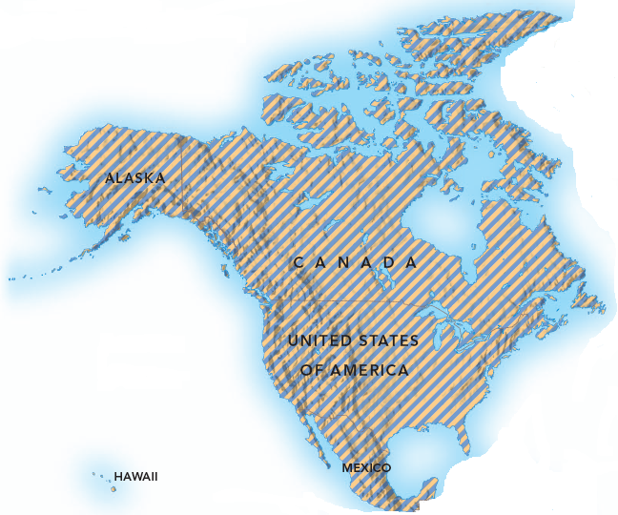
Economic Bloc
A geographic area consisting of two or more countries that agree to pursue economic integration by reducing tariffs and other barriers to the cross-border flow of products, services, capital, and, in more advanced cases, labor.
Examples: European Union, NAFTA,
MERCOSUR, APEC, ASEAN, and
many others.
There are five possible
levels of economic integration.
Notes:
More advanced economic blocs, such as the EU, permit the free flow of capital, labor, and technology among their member countries. The EU is also harmonizing monetary policy (to manage the money supply and currency values) and fiscal policy (to manage government finances, especially tax revenues) and gradually integrating the economies of its member nations. In recent years, cross-border merger and acquisition deals have increased markedly among firms from Austria, Britain, France, and other member countries. Why would a nation opt to be a member of an economic bloc instead of working toward a system of worldwide free trade? The main reason is that reaching agreement on free trade is much easier in negotiations among a handful of countries than among all the nations in the world. This helps explain why there are hundreds of regional trade integration blocs around the world today. They present both opportunities and challenges to internationalizing firms.
Since 1947, the General Agreement on Tariffs and Trade (GATT) and later the World Trade Organization (WTO) have achieved great success in fostering economic integration on a global scale. In addition, the WTO recognizes regional integration can play an important role in liberalizing trade and fostering economic development. However, regional economic blocs are powerful and the WTO has encountered various challenges in dealing with them. Slow progress in liberalizing trade, especially for agricultural products, has prompted many developing countries to seek alternatives to the global trading system favored by the WTO. The WTO is continuing negotiations with economic blocs, with the aim of exercising better control over their evolution and of minimizing risks associated with regional economic integration.

Slide 35
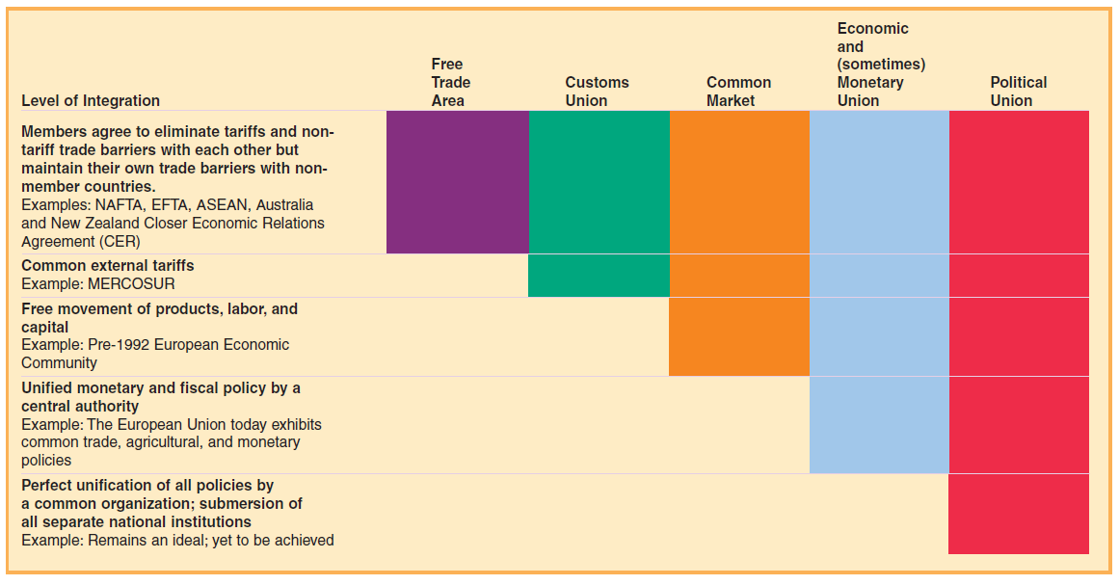
Five Potential Levels of Regional Integration
Notes:
The Exhibit identifies five possible levels of regional integration. We can think of these levels as a continuum, with economic interconnectedness progressing from a low level of integration—the free trade area—through higher levels to the most advanced form of integration—the political union. The political union represents the ultimate degree of integration among countries, which no countries have yet achieved.
The United States provides a good analogy for an economic union. Imagine each state is like an individual country, but all are joined together in a union. The members have a common currency and a single central bank with a uniform monetary policy. Trade among the members takes place unobstructed, and both labor and capital move freely among them. The federal government applies a uniform tax and fiscal policy. Just as would occur in an economic union, the individual U.S. states also govern themselves in such areas as education, police protection, and local taxes. This analogy only goes so far, of course. The United States is a country and, unlike members of a real economic union, the states cannot withdraw.

Slide 36
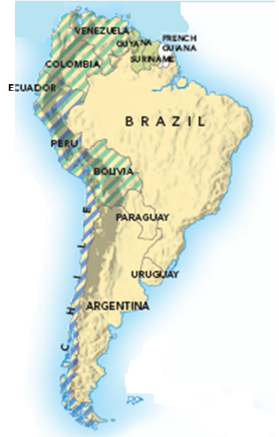
Levels of Regional Integration (1 of 2)
Free trade area: Simplest, most common arrangement. Member countries agree to gradually eliminate formal trade barriers within the bloc, while each member maintains an independent international trade policy with countries outside the bloc. One example is N A F T A.
Customs union: Similar to a free trade area except the members harmonize their trade policies toward nonmember countries, by enacting common tariff and nontariff barriers on imports from nonmember countries. M E R C O S U R is an example.
Notes:
The free trade area is the simplest and most common arrangement, in which member countries agree to gradually eliminate formal barriers to trade in products and services within the bloc, while each member country maintains an independent international trade policy with countries outside the bloc. NAFTA is an example. The free trade area emphasizes the pursuit of comparative advantage for a group of countries rather than for individual states. Governments may impose local content requirements, which specify that producers located within the member countries provide a certain proportion of products and supplies used in local manufacturing. If the content requirement is not met, the product becomes subject to the tariffs that member governments normally impose on nonmember countries.
The customs union is the second level of regional integration, similar to a free trade area except that member states harmonize their external trade policies and adopt common tariff and nontariff barriers on imports from nonmember countries. MERCOSUR, an economic bloc in Latin America, is an example of this type of arrangement. The adoption of a common tariff system means that an exporter outside MERCOSUR faces the same tariffs and nontariff barriers when trading with any MERCOSUR member country. Determining the most appropriate common external tariff is challenging, because member countries must agree on the level and on how to distribute proceeds from the tariff among the member countries.

Slide 37
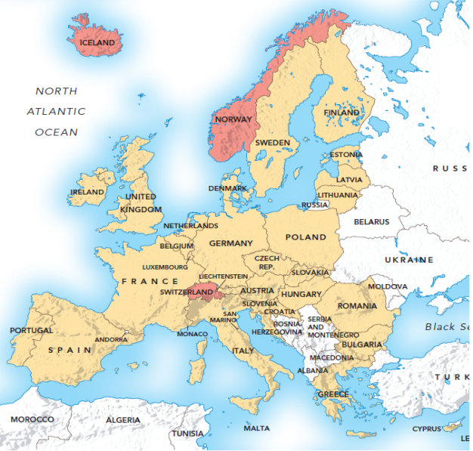
Levels of Regional Integration (2 of 2)
Common market: Like a customs union, except products, services, and factors of production such as capital, labor, and technology can move freely among the member countries. e.g., The E U countries put in place many common labor and economic policies.
Economic union: Like a common market, but members also aim for common fiscal and monetary policies, and standardized commercial regulations. The E U is moving toward an economic union by forming a monetary union with a single currency, the euro.
Notes:
In the third stage of regional integration, member countries establish a common market (also known as a single market), in which trade barriers are reduced or removed, common external barriers are established, and products, services, and factors of production such as capital, labor, and technology are allowed to move freely among the member countries. Like a customs union, a common market also establishes a common trade policy with nonmember countries. The EU is a common market. It has gradually reduced or eliminated restrictions on immigration and the cross-border flow of capital. A worker from an EU country has the right to work in other EU countries, and EU firms can freely transfer funds among their subsidiaries within the bloc. Common markets are hard to create because they require substantial cooperation on labor and economic policies. Since labor and capital can flow freely inside the bloc, benefits to individual members vary; skilled labor may move to countries where wages are higher, and investment capital may flow to countries where returns are greater. In the EU, for example, Germany has seen an influx of workers from Poland and the Czech Republic, because these workers can earn substantially higher wages in Germany than they can at home.
An economic union is the fourth stage of regional integration, in which member countries enjoy all the advantages of early stages but also strive to have common fiscal and monetary policies. At the extreme, each member country adopts identical tax rates. The bloc aims for standardized monetary policy, which requires establishing fixed exchange rates and free convertibility of currencies among the member states, in addition to allowing the free movement of capital. This standardization helps eliminate discriminatory practices that might favor one member state over another. Through greater mobility of products, services, and production factors, an economic union enables firms within the bloc to locate productive activities in member states with the most favorable economic policies.

Slide 38
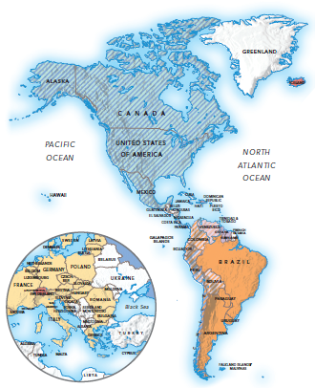
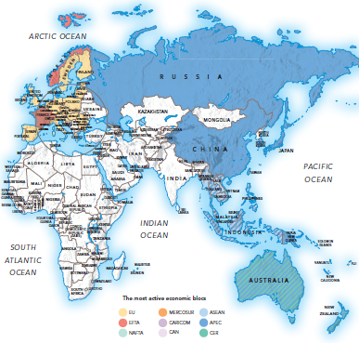
The Most Active Economic Blocs

Slide 39
The E U: A Full-Fledged Economic Union
Market access. Tariffs and most nontariff barriers have been eliminated.
Common market. Barriers to cross-border movement of production factors-labor, capital, and technology.
Trade rules. Cross-national customs procedures and regulations have been eliminated, which has streamlined transportation and logistics within Europe.
Standards harmonization. Technical standards, regulations, and enforcements have been harmonized.
Common fiscal, monetary, taxation, and social welfare policies is the ultimate goal over time.
Notes:
Over time, the EU has taken the following steps on its path to becoming a full-fledged economic union:
■ Market access. Tariffs and most nontariff barriers have been eliminated for trade in products and services, and rules of origin favor manufacturing using parts and other inputs produced in the EU.
■ Common market. Barriers to the cross-national movement of production factors— labor, capital, and technology—have been removed. For example, an Italian worker now has the right to get a job in Ireland, and a French company can invest freely in Spain.
■ Trade rules. The member countries have largely eliminated customs procedures and regulations, which streamlines transportation and logistics within Europe.
■ Standards harmonization. The EU is harmonizing technical standards, regulations, and enforcement procedures that relate to products, services, and commercial activities.
Where British firms once used the imperial measurement system (pounds, ounces, and inches), they have converted to the metric system used by all EU countries. Where German food merchants once had their own standard for handling meat and produce, they now follow procedures prescribed by the EU.
In the long run, the EU is seeking to adopt common fiscal, monetary, taxation, and social welfare policies. The 2002 introduction of the euro—the EU’s common currency and now one of the world’s leading currencies—simplified the process of cross-border trade and enhanced Europe’s international competitiveness. Its introduction eliminated exchange rate risk in much of the bloc and forced member countries to improve their fiscal and monetary policies. The single currency allows consumers and businesses to think of Europe as a single national entity. However, national governments had to cede monetary power to the European Central Bank, which is based in Luxembourg and oversees EU monetary functions.

Slide 40
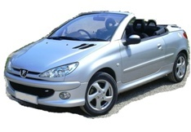
The European Union Today (1 of 2)
27 members. Founders members are Belgium, Italy France, Germany, Luxembourg, and the Netherlands.
New members such as Poland, Hungary, Czech Republic - are low-cost manufacturing sites.
  Peugeot, Citroën (France) - factories in Czech Republic
  Hyundai (South Korea) - Kia plant in Slovakia
  Suzuki (Japan) - factory in Hungary
Notes:
Since 2004, twelve new states have joined, and the recent addition of Bulgaria and Romania brings the total number of member countries to twenty-seven. The new members are important, low-cost manufacturing sites for EU firms.4 Peugeot and Citroën now produce cars at a plant in the Czech Republic that, at full capacity, can turn out 320,000 vehicles per year. South Korea’s Hyundai now produces the Kia brand of cars at a plant in Slovakia, while Japan’s Suzuki makes cars in Hungary. Output of automobiles in the eastern region is growing rapidly.5 Most of the newest EU entrants are one-time satellites of the former Soviet Union and have economic growth rates higher than their fifteen Western European counterparts. They are poised to achieve per-capita income levels similar to those of the EU’s wealthier countries within several years. However, their ascension poses special challenges. Less-developed economies such as Romania, Bulgaria, and Lithuania will require years of developmental aid to catch up.6 The EU faces other challenges as well, including the tension between the forces for regional integration and the forces for retaining national identity. EU countries recognize that relinquishing autonomy in certain key areas and combining resources across national borders are necessary steps. However, some, particularly Britain, are reluctant to surrender certain sovereign rights. They insist on maintaining their ability to set their own monetary and fiscal policies and to undertake their own national military defense. The Common Agricultural Policy (CAP) has long been a fixture of the European bloc. The CAP is a system of agricultural subsidies and programs that guarantees a minimum price to EU farmers and ranchers. Its original goals were to provide a fair living standard for agricultural producers and food at reasonable prices. In reality, however, the CAP has increased food prices in Europe and consumes almost half the EU’s annual budget while complicating negotiations with the WTO for reducing global trade barriers. The CAP’s high import tariffs also affect exporters in developing economies, such as Africa, that rely heavily on agricultural production. The EU is working to reform the CAP, but progress has been slow.

Slide 41
The European Union Today (2 of 2)
Most new E U entrants are in Eastern Europe - one-time satellites of the Soviet Union, most are emerging markets with fast economic growth rates.
In 2016, the United Kingdom (U.K.) voted to withdraw from the European Union. In the wake of ‘Brexit’, the U.K. may exit from the EU altogether. Or it may adopt an approach similar to Norway, which maintains free movement of goods, capital, and workers with the EU but is not an EU member and follows only selected EU regulations.

Slide 42
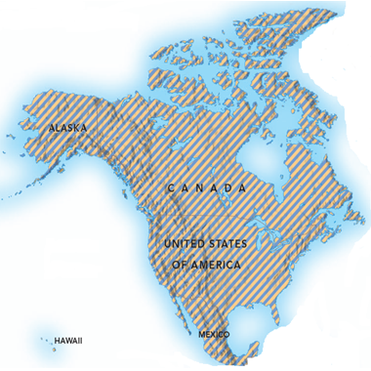
N A F T A (Canada, Mexico, the United States) (1 of 2)
The North American Free Trade Agreement (N A F T A) was passed in 1994 and established free trade among the member countries.
Since its inception, Canada and Mexico became the top export markets of the United States.
2018, a new agreement was reached to replace NAFTA, called the United States–Mexico–Canada Agreement (USMCA).
Notes:
Consisting of Canada, Mexico, and the United States, NAFTA launched in 1994. It is the most significant economic bloc in the Americas and comparable to the EU in size. Its passage was smoothed by the existence, since the 1960s, of the maquiladora program. Under this program, U.S. firms were allowed to locate manufacturing facilities in an area just south of the U.S. border and access low-cost labor and other advantages in Mexico without having to pay significant tariffs.

Slide 43
N A F T A (Canada, Mexico, the United States) (2 of 2)
N A F T A:
Eliminated tariffs and most nontariff barriers for products and services.
Established trade and investment rules, uniform customs procedures, and intellectual property rights.
Provided procedures for settling trade disputes.
Notes:
Consisting of Canada, Mexico, and the United States, NAFTA launched in 1994. It is the most significant economic bloc in the Americas and comparable to the EU in size (see www.nafta-sec-alena.org). Its passage was smoothed by the existence, since the 1960s, of the maquiladora program. Under this program, U.S. firms were allowed to locate manufacturing facilities in an area just south of the U.S. border and access low-cost labor and other advantages in Mexico without having to pay significant tariffs.

Slide 44
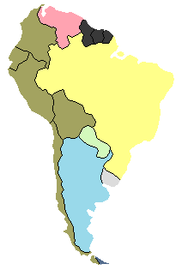
El Mercado Comun del Sur (M E R C O S U R)
The leading economic bloc in South America, accounting for nearly all of the region’s GDP.
Launched in 1991, the four initial members were Argentina, Brazil, Paraguay, and Uruguay.
Established free movement of products and services, common external tariff and trade policy, and coordinated monetary and fiscal policies.
May be integrated with NAFTA and DR-CAFTA as part of a future Free Trade Area of the Americas.
Notes:
Established in 1991, MERCOSUR, or the El Mercado Comun del Sur (the Southern Common Market), is the strongest economic bloc in South America (see www.mercosur.int). Within its borders, MERCOSUR established the free movement of products and services, a common external tariff and trade policy, and coordinated monetary and fiscal policies. An additional priority is the construction of reliable infrastructure—roads, electricity grids, and gas pipelines—across a landmass larger than Mexico and the United States combined. MERCOSUR eventually aims to become an economic union. MERCOSUR’s early progress was impressive. It attracted much investment from nonmember countries, especially in the auto industry. During its first six years, trade among the member countries tripled.11 In addition to its regular members, MERCOSUR also has five associate members, which have access to preferential trade but not to the tariff benefits of full members. MERCOSUR also has trade agreements with nations outside the bloc. In the future, it may become integrated with NAFTA and the Dominican Republic–Central American Free Trade Agreement (DR-CAFTA) as part of a proposed Free Trade Area of the Americas (FTAA), bringing free trade to the entire western hemisphere.

Slide 45
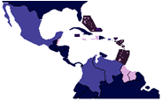
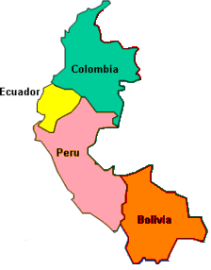
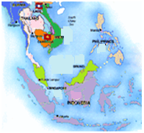
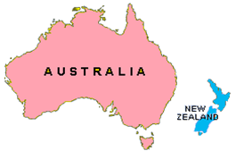
Other Economic Blocs
Caribbean Community and Common Market (C A R I C O M).
Comunidad Andina de Naciones (C A N).
Association of Southeast Asian Nations (A S E A N).
Asia Pacific Economic Cooperation
(A P E C).
Australia and New Zealand Closer Economic Relations Agreement (C E R).
Notes:
Composed of roughly twenty-five member and associate member states around the Caribbean Sea, CARICOM was established in 1973 to lower trade barriers and institute a common external tariff (see www.caricom.org). The bloc has met with little success in stimulating economic development, however, due to economic difficulties of the individual members and their inability to agree on basic issues. The bloc is progressing toward establishing the Caribbean Single Market, a common market that allows for a greater degree of free movement for products, services, capital, and labor and gives citizens of all CARICOM countries the right to establish businesses throughout the region.
Long called the Andean Pact, the CAN was established in 1969. Its main members are Bolivia, Colombia, Ecuador, and Peru (see www .comunidadandina.org). CAN is expected to merge with MERCOSUR to form a new economic bloc that encompasses all of South America. The pact achieved little progress in its first twenty years, with intrabloc trade reaching only 5 percent of the bloc members’ total trade.12 This low trade rate is partially due to geography: The Andes mountain range makes cross-border land transportation costly and cumbersome.
ASEAN was created in 1967 with the goal of maintaining political stability and promoting regional economic and social development among its members, shown in Exhibit 9.7 (see www.aseansec.org). ASEAN created a free trade area in which many tariffs were reduced to less than 5 percent. Further regional integration has been slowed by large economic differences among the member countries. For example, oil-rich Brunei has a per-capita income of nearly $50,000, while Vietnam's is only about $3,000. Were ASEAN to become a common market or economic union, millions of job seekers from poor member countries would probably migrate to wealthier member countries, potentially disrupting the economies of these latter nations. Consequently, ASEAN is unlikely to advance beyond its free trade area status for decades to come. In the long run, ASEAN aims to incorporate international trading powerhouses like Japan and China, whose membership would accelerate the development of extensive trade relationships.
APEC aims for greater free trade and economic integration of the Pacific Rim countries. It incorporates twenty-one nations on both sides of the Pacific, including Australia, Canada, Chile, China, Japan, Mexico, Russia, and the United States (see www.apec.org). Its members account for 75 percent of total regional trade, as well as one-third of the world’s population and over half its GDP. APEC aspires to remove trade and investment barriers by 2020. Progress has been slowed by economic and political turmoil in some member countries, as well as failure to agree on foundational issues. Members also have varying national economic priorities, and the inclusion of less-affluent Asian countries alongside strong international traders like Australia, Japan, and the United States complicates agreement on a range of issues.
In 1966, Australia and New Zealand reached a free trade agreement that removed 70 percent of tariffs and quotas between the two nations, but it was relatively complex and bureaucratic. In 1973, the Closer Economic Relations Agreement (CER) sought to accelerate free trade, leading to further economic integration of the two nations. The CER gained importance when Australia and New Zealand lost their privileged status in the British market as Britain joined the EU. Many believe the CER has been one of the world’s most successful economic blocs. In 2009, its members concluded important negotiations on creating a free trade agreement with the ASEAN countries.

Slide 46
Why Do Nations Pursue Economic Integration? (1 of 2)
Expand market size
  Increases size of the marketplace for firms inside the economic bloc. Belgium has a population of just 10 million; the E U has a population of nearly 500m.
  Buyers can access larger selection of goods.
Achieve economies of scale and productivity
  Bigger market facilitates economies of scale.
  Internationalization inside the bloc helps firms learn to compete outside the bloc.
  Competition and efficient resource usage inside
  the bloc leads to lower prices for bloc consumers.
Notes:
Expand market size. Regional integration greatly increases the scale of the marketplace for firms inside the economic bloc. For example, while Belgium has a population of just 10 million, the absence of trade barriers with other countries in the EU gives Belgian firms easier access to a total market of roughly 500 million EU buyers. In a similar way, management at Allianz, the German insurance firm featured in the opening vignette, has come to view Europe as one large marketplace. When NAFTA was formed, Canadian firms gained access to the much larger markets of Mexico and the United States, and consumers in all three countries access a wider selection of products and services.
Achieve scale economies and enhanced productivity. Expansion of market size within an economic bloc gives member country firms the opportunity to increase the scale of operations in both production and marketing, gaining greater concentration and increased efficiency. While a German firm may be only moderately efficient when producing 10,000 units of product for Germany, it greatly increases its efficiency by producing 50,000 units for the much larger EU market. Internationalization inside the bloc helps firms learn to compete outside the bloc as well. The firms enjoy additional benefits through increased access to factors of production that now flow freely across national borders within the bloc. Labor and other inputs are allocated more efficiently among the member countries. More efficient resource usage leads to lower prices for consumers.

Slide 47
Why Do Nations Pursue Economic Integration? (2 of 2)
Attract direct investment from outside the bloc
  Compared to investing in stand-alone countries,
  foreign firms prefer to invest in countries belonging
  to an economic bloc. General Mills, Samsung, and
  Tata have invested heavily in E U-member countries.
Acquire stronger defensive and political posture
  Belonging to a bloc provides member countries with
  a stronger defensive posture relative to other nations and world regions. This was a key motive for formation of the European Union.
Notes:
Attract direct investment from outside the bloc. Foreign firms prefer to invest in countries that are part of an economic bloc because factories they build there receive preferential treatment for exports to all member countries within the bloc. For example, many non-European firms— including General Mills, Samsung, and Tata—invested heavily in the EU to take advantage of Europe’s economic integration. By establishing operations in a single EU country, these firms gain free trade access to the entire EU market.
Acquire stronger defensive and political posture. One goal of regional integration is to strengthen member countries relative to other nations and world regions. This was one of the motives for creating the European Community (the precursor to the EU), whose members sought to strengthen their mutual defense against the expanding influence of the former Soviet Union. Today, the EU is one way Europe counterbalances the power and international influence of the United States. Forming an economic bloc also helps countries gain bargaining and political power in world affairs. For example, the EU enjoys greater influence with the WTO in trade negotiations than any individual member country. Broadly speaking, countries are more powerful when they cooperate than when they operate alone.

Slide 48
Implications of Regional Integration for the Firm
Internationalization by firms inside the economic bloc. Regional integration facilitates company internationalization. Expansion into neighboring countries provides valuable experience, prompting internationalization to other markets worldwide.
Rationalization of operations. By restructuring and consolidating company operations, managers can develop strategies and value-chain activities suited to the region as a whole, not just individual countries. Goal is to cut costs and redundancy, and increase efficiencies via scale economies.
Notes:
Internationalization by firms inside the economic bloc. Initially, regional integration pressures or encourages companies to internationalize into neighboring countries within the bloc. The elimination of trade and investment barriers also presents new opportunities to source input goods from foreign suppliers within the bloc. Internationalizing into neighboring, familiar countries also provides the firm with the skills and confidence to further internationalize to markets outside the bloc. For example, after the formation of NAFTA, many U.S. companies entered Canada and gained valuable international experience that inspired them to launch ventures into Asia and Europe.

Slide 49
Implications for the Firm
Regional products and marketing strategy. Firms cut costs by standardizing products and services. Case Inc. reduced its Magnum line of tractors from 17 to only a few versions in Europe, following integration of the E U.
Internationalization by firms from outside the bloc. Because external trade barriers mainly affect exporting, many foreign firms prefer to enter a bloc through F D I. In this way, after formation of the E U, Britain became the largest recipient of F D I from the United States.
Notes:
Rationalization of operations. The creation of an economic bloc decreases the importance of national boundaries. Instead of viewing the bloc as a collection of disparate countries, firms begin to view the bloc as a unified whole. Managers develop strategies and value-chain activities suited to the region as a whole, rather than to individual countries. Rationalization is the process of restructuring and consolidating company operations following regional integration to reduce redundancy and costs and increase the efficiency of operations. Management may combine two or more factories into a single factory, eliminating duplication and increasing economies of scale. In this way, the firm that formerly operated factories in each of several countries benefits by consolidating the factories into a single, central location inside the economic bloc. Caterpillar, the U.S. manufacturer of earth-moving equipment, was one of many firms that shifted its focus from serving individual European countries to serving the EU region. Caterpillar undertook a massive program of rationalization and modernization at its EU plants to streamline production, reduce inventories, increase economies of scale, and lower operating costs. Companies can apply rationalization to other value-chain functions such as distribution, logistics, purchasing, and R&D. Formation of the EU and subsequent elimination of trade barriers, customs checkpoints, and country-specific transportation regulations allowed U.S. firms to restructure their EU distribution channels to make them better suited to the greatly enlarged EU marketplace. Creation of the economic bloc eliminated the need for separate distribution strategies in individual countries. Instead, the firms were able to employ a global approach for the larger marketplace, generating economies of scale in distribution.
Mergers and acquisitions. The formation of economic blocs also leads to mergers and acquisitions (M&A), sometimes due to rationalization. Two giant engineering firms, Asea AB of Sweden and Brown, Boveri & Co. of Switzerland, merged to form Asea Brown Boveri (ABB), facilitated by development of the EU. The merger allowed the new firm to increase its R&D activities and pool greater capital funding for major projects, such as construction of power plants and large-scale industrial equipment.

Slide 50
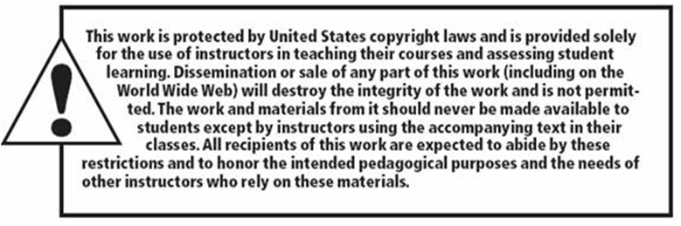
Copyright

